Slide 1
The Future of the Employment Arbitration
What do the next 10-15 years look Like?

Slide 2
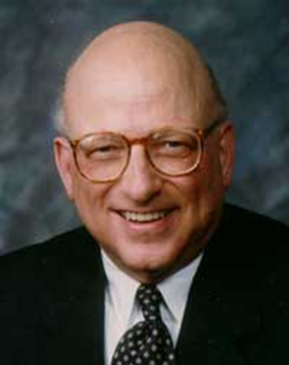
The “Future of Workplace ADR Series” is dedicated to
Professor David Lipsky (retired), Cornell University
Past President of LERA
(and mentor to hundreds)

Slide 3
Rules of the Road Today
This is a conversation, not a presentation
Enter muted
Stay muted until ready to speak
Initially use chat to pose your questions
We’ve allocated plenty of time for them at the end!
Hold the verbal discussion until the end
This session will be recorded and available on LERA
Must end session on time after 60 minutes

Slide 4
Panelists:
Jacquelin F. Drucker, Esq. – Arbitrator
Christine Newhall – Senior Vice President, American Arbitration Association
Moderator:
Mark D. Gough – Assistant Professor of Labor and Employment Relations, Penn State

Slide 5
What IS Employment Arbitration?

Slide 6
Does it have a future?
Enforceability of pre-dispute employment arbitration agreements and plans: What will Congress do?
Pending legislation: The Pro Act and the FAIR Act
CBAs exempt

Slide 7
What Do Future Employment Arbitration Proceedings Look Like?
Long-term use of virtual platforms for hearing
Use of virtual platforms for prehearing steps
Hybrid Hearings

Slide 8
The Employment Arbitration Panel of the American Arbitration Association
Background and standards
Balance
Plans for Future
Diversity

Slide 9
Accessibility of the Forum
Fulfilling the promise of arbitration in the employment arena
Discovery Protocols
Expedition of proceedings
St. Antoine, “Making Employment Arbitration Fair and Accessible” Penn State Arbitration Law Review

Slide 10
What Does the Future Hold for Pro Se Parties?
AAA’s Pro Se Program
Access to legal guidance

Slide 11
What is the Outlook for Multiple-Case Filings?

Slide 12
Update on your chat comments
Chat monitor

Slide 13
You are invited to join LERA as a national member
- And complimentary membership in the
LERA Dispute Resolution Section (DRS)
-Also look for your local LERA chapter

Slide 14
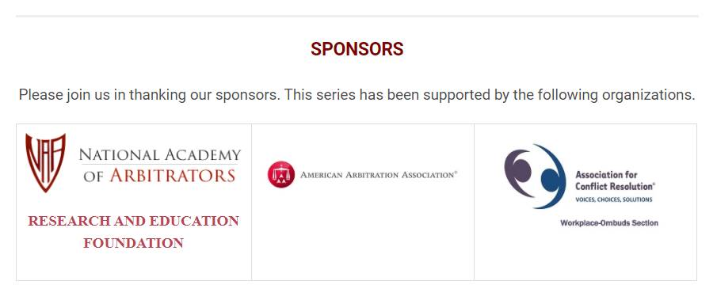
Up Next: What Does the Process of Labor Arbitration Look Like in the Future? (1:15-2:15 pm ET)

