Slide 1

The Future of the Labor Arbitration Process
What Does the next 10-15 Years Look Like?

Slide 2
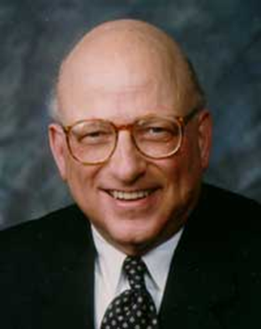
The “Future of Workplace ADR Series”
is dedicated to
Professor David Lipsky (retired), Cornell University
Past President of LERA
(and mentor to hundreds)

Slide 3
Design of Discussions
First session is focused on the future of the legal/structural landscape of the labor arbitration process
Second session is focused on the future of process and procedure in arbitration

Slide 4
Rules of the Road Today
  This is a conversation, not a presentation
  Enter muted
  Stay muted until ready to speak
  Initially use chat to pose your questions
  Hold the verbal discussion until the end
  This session will be recorded and available on LERA
  Must end session on time after 60 minutes

Slide 5
Panelists:
  Arthur Pearlstein – Director of Arbitration, Federal Mediation and Conciliation Service
  Frank Binda – Assistant Vice President, American Arbitration Association
  Jeanne Charles - Arbitrator and Mediator, NAA Member
Moderator:
  Mark C. Travis – Arbitrator and Mediator, Travis ADR Services, LLC. NAA Member.

Slide 6
The Virtual Process
  Will virtual arbitration (or hybrid) remain the norm? How will it change the process?
  Will hearings become paperless?
  Will utilization of court reporters decrease with recordings?
  Will we see increasing legalization/formalization?
  Will pre-hearing conferences (document and witness exchange) become the norm?
  Will it offer more opportunity for early resolution?
  What involvement will administering agencies have in virtual process?

Slide 7
Innovation and Expansion in the Practice
  What will be the role of administering agencies in diversity and inclusion?
  Will the pool of diverse neutrals bring new skills?
  What is the possibility of increased use of med/arb, grievance mediation or expedited arbitration?

Slide 8
Update on your chat comments
Chat monitor

Slide 9
You are invited to join LERA as a national member
- And complimentary membership in the
LERA Dispute Resolution Section (DRS)
-Also look for your local LERA chapter

Slide 10
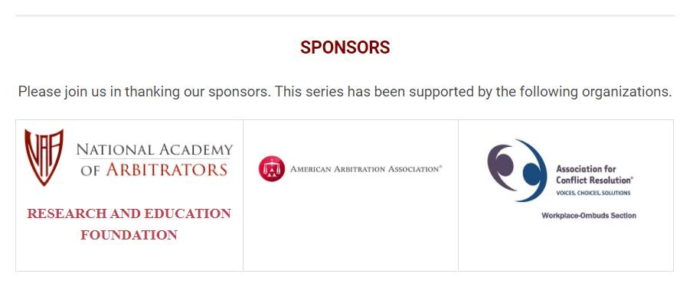
Adjourn and thank you

