Slide 1

The Future Landscape of Labor Arbitration
What Does it Look Like?

Slide 2
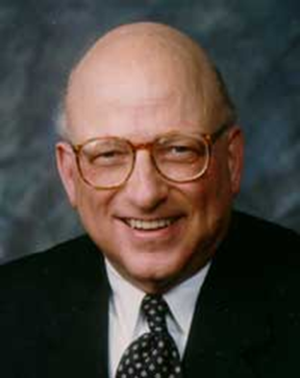
The “Future of Workplace ADR Series”
is dedicated to
Professor David Lipsky (retired), Cornell University
Past President of LERA
(and mentor to hundreds)

Slide 3
Design of Discussions
First session is focused on the future of the legal/structural landscape of the arbitration process
Second session is focused on the future of process and procedure in arbitration

Slide 4
Rules of the Road Today
This is a conversation, not a presentation
  Enter muted
  Stay muted until ready to speak
  Initially use chat to pose your questions
  Hold the verbal discussion until the end
  This session will be recorded and available on LERA
  Must end session on time after 60 minutes

Slide 5
Panelists:
  Stephen Befort – Gray, Plant, Mooty, Mooty, & Bennett Professor of Law, University of Minnesota Law School. NAA Member
  Martin H. Malin - Martin H. Malin, Professor of Law and Co-Director, Institute for Law and the Workplace, Chicago-Kent College of Law, Illinois Institute of Technology. NAA Member.
  Christine Newhall – Senior Vice President, American Arbitration Association
Moderator:
  Mark C. Travis – Arbitrator and Mediator, Travis ADR Services, LLC. NAA Member.

Slide 6
The Legal/Political Perspective
  Will more state governments try to eliminate public sector collective bargaining?
  Will more state governments enact right-to-work laws?
  What changes can we anticipate in arbitration of police misconduct conduct cases? Will it reduce arbitrator discretion?
  Will we see changes in SCOTUS deference to labor arbitration awards and/or the Trilogy?
  What changes can be expected in federal sector labor arbitration?

Slide 7
The Broader Profession
  What changes will be seen in diversity initiatives? What impact will those have on the profession?
  What roles will the parties play in these changes?
  Will eligibility standards will be affected?

Slide 8
Increasing Legalization in Arbitration?
  Will labor arbitration suffer from increasing legalization, a la employment arbitration?
  With concentration in certain sectors, will ad hoc selection become more the norm?
  Has there been a shift in the 80/20 rule – in either direction?

Slide 9
Update on your chat comments
Chat monitor

Slide 10
You are invited to join LERA as a national member
- And complimentary membership in the
LERA Dispute Resolution Section (DRS)
-Also look for your local LERA chapter

Slide 11
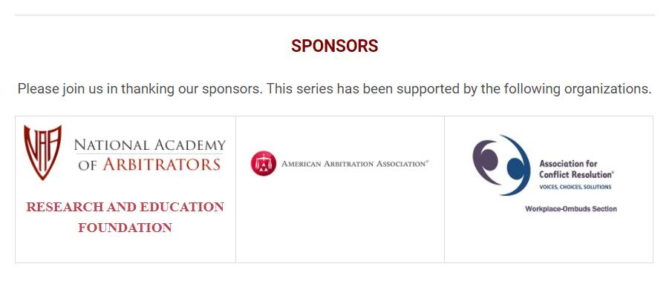
Adjourn and thank you

