Slide 1
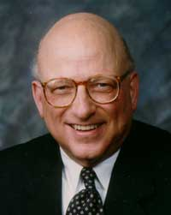
The “Future of Workplace ADR Series” is dedicated to
Professor David Lipsky (retired), Cornell University
Past President of LERA
(and mentor to hundreds)

Slide 2
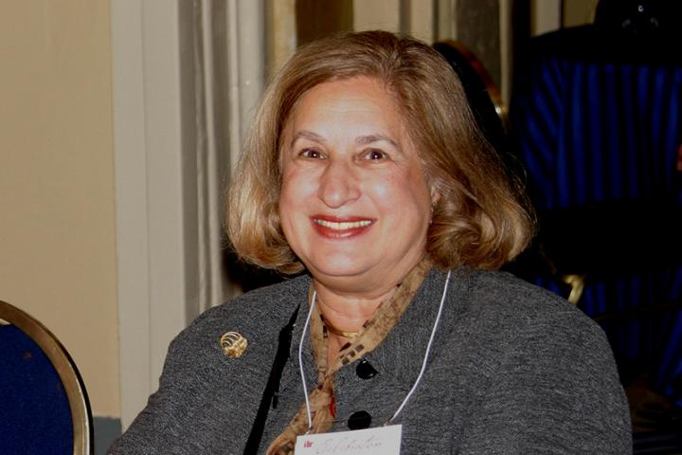
The “Future of Workplace ADR Series”
Honors the Memory of
Arbitrator Marcia Greenbaum
1941-2021
Past President, Pioneer Award Winner, Society of Professionals in DR; Lifetime Achievement Award, LERA;
Mentor, Leader, DR Program Developer

Slide 3
For our meeting today . . .
This is a conversation, not a presentation
Audience may pose questions through chat – please direct questions to Tom Melancon
Please stay muted throughout the program – ok to turn video on
This session will be recorded and available on LERA website
We will end on time after 60 minutes
Next session begins at 1:15pm ET/10:15am PT

Slide 4
Beyond Zoom: How Technology is Transforming Mediation Practice and the Profession 12:00–1:00 pm ET
Danielle Carne ♦ Josh Flax ♦ David Larson
Moderators
Janet Gillman & Tom Melancon
LERA Dispute Resolution Section

Slide 5
Janet Gillman
State Conciliator, Oregon Employment Relations Board
LERA DR Section Practice Leader in Public Sector Labor Relations & Interest-Based Negotiation
Tom Melancon
Strategy Officer, Federal Mediation and Conciliation Service, Seattle
LERA DR Section Practice Leader in Mediation

Slide 6
Danielle Carne
Arbitrator & Mediator, Carne Dispute Resolution, Madison, Wisconsin
Adjunct Professor, University of Wisconsin Law School
Former Co-Chair of the LERA Dispute Resolution Interest Section

Slide 7
Josh Flax
Chief Strategy Officer, Federal Mediation and Conciliation Service, Washington D.C.

Slide 8
David Larson
Professor of Law, Mitchell Hamline School of Law and Senior Fellow at the Dispute Resolution Institute
Fellow for the National Center for Technology and Dispute Resolution and the American Bar Foundation
Chair Elect of the ABA Dispute Resolution Section and Co-Chair of the Section’s ODR Standards Task Force

Slide 9
Guiding questions for the panel:
What does your current experience tell you about where technology may be taking the field of workplace mediation over the next 10-15 years?
In what ways do see technology advancing and/or impeding what is essential to effective mediation practice?

Slide 10
Word Cloud
What single word describes an
essential feature of effective workplace mediation?
Click on the link in the chat box and place one word in the Poll Everywhere poll (you do not have to enter your name)

Slide 11
Danielle Carne

Slide 12
Interesting Features of the Virtual Meeting Space
Access
Attention Span & Focus
Constant Running Comparison to In-Person Meetings

Slide 13
Best Practices (Thus Far!) of the Virtual Meeting Space
Celebrate Expanded Access
Chop Down Meeting Duration
Employ Varied Technology Platforms To Add Value
How I Learned to Stop Worrying and Embrace the Virtual

Slide 14
Reimagine Justice
Practices should drive tech, not vice versa
Or… embrace tech and reimagine justice

Slide 15
Broad set of technologies that either supplement or replace ways in which people have traditionally resolved disputes (Resolution Systems Institute) NCSC - explicitly designed to assist litigants in resolving disputes, rather than only support judicial or court staff decision-making Communication technologies, algorithms, blind bidding, artificial intelligence?

Slide 16
ODR Can Improve A2J
Shame, fear, no vacation time, transportation issues, childcare, physically intimidated by other party, disability
ODR can improve A2J, but….
ICODR Stds (Co-Chair, ABA ODR Standards Task Force)

Slide 17
Mediators’ dirty little secret multiplied
Enhanced authority of neutral -
combined process and technology expert
Alter form and voice
Adobe Audition – pitch and timbre
Control timing/alter information
©David Allen Larson

Slide 18
Be transparent as possible (reached out) Anticipate conflicts/tensions state government policies Taint Request for Proposals? Legal service advocates unaware - multiple consumer protection features Top down not bottom up – enlist highest levels of the judiciary from outset
New York Unified State Court
Online Credit Card Debt Collection System
©David Allen Larson

Slide 19
NYC Small Claims – Goods and Services
$10,000 or less
Challenges – not fully digitized
nCourt fees collection, Clerk of Court case mgmt.
No assigned court hearing dates, how long ODR?
“Hard and soft” opt outs
Animated videos

Slide 20
ODR PROCESS
Blind bidding
Three rounds – Wish to/Would
When settled? Amount? Least desirable - Would
Direct negotiation – terms: ex. # of payments, default
Structured and direct message (conversation)
Auto populate Stipulation of Settlement
Mediation – community mediation centers
More coordination and training, own dashboard, Consent

Slide 21
Audience Questions and Comments

Slide 22
You are invited to join LERA as a member
And complimentary membership in the
LERA Dispute Resolution Section (DRS)
www.leraweb.org

Slide 23
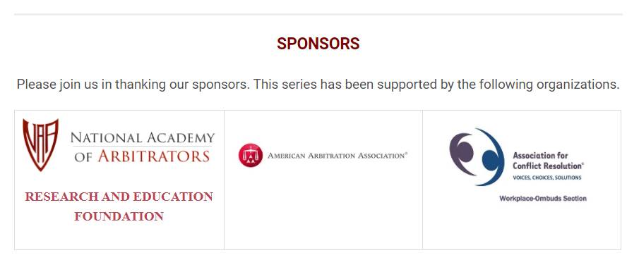
Adjourn and thank you
Next session on Mediation Process Design begins at 10:15am PT/1:15pm ET

