Slide 1

Designing Dispute Resolution Processes to More Fully Address and Resolve Workplace Conflict
1:15 – 2:15 pm ET
Susan Stewart ♦ Jennifer Pernfuss ♦ Pete Swanson
Moderators
Janet Gillman & Tom Melancon
LERA Dispute Resolution Section

Slide 2
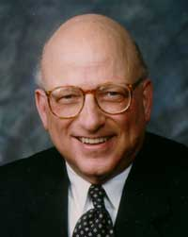
The “Future of Workplace ADR Series” is dedicated to
Professor David Lipsky (retired), Cornell University
Past President of LERA
(and mentor to hundreds)

Slide 3
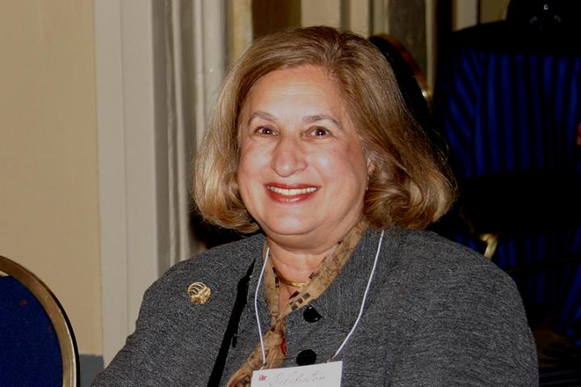
The “Future of Workplace ADR Series”
Honors the Memory of
Arbitrator Marcia Greenbaum
1941-2021
Past President, Pioneer Award Winner, Society of Professionals in DR; Lifetime Achievement Award, LERA;
Mentor, Leader, DR Program Developer

Slide 4
For our meeting today . . .
    This is a conversation, not a presentation
    Audience may pose questions through chat – please direct questions to Tom Melancon
    Please stay muted throughout the program – ok to turn video on
    This session will be recorded and available on LERA website
    We will end on time after 60 minutes
    Next session begins at 2:30pm ET/11:30am PT

Slide 5
Designing Dispute Resolution Processes to More Fully Address and Resolve Workplace Conflict
1:15 – 2:15 pm ET
Susan Stewart ♦ Jennifer Pernfuss ♦ Pete Swanson
Moderators
Janet Gillman & Tom Melancon
LERA Dispute Resolution Section

Slide 6
Janet Gillman
State Conciliator, Oregon Employment Relations Board
LERA DR Section Practice Leader in Public Sector Labor Relations & Interest-Based Negotiation
Tom Melancon
Strategy Officer, Federal Mediation and Conciliation Service, Seattle
LERA DR Section Practice Leader in Mediation

Slide 7
Susan Stewart
Arbitrator & Mediator, Pax Dispute Resolution Ltd, Toronto, Canada
President, Ontario Labour Management Arbitrators’ Association
President Elect, National Academy of Arbitrators

Slide 8
Jennifer Pernfuss
Organization and Relationship Systems Coach/Consultant and Founder of RESPECT: Conciliation and Education, Toronto, Canada

Slide 9
Peter Swanson
Chief Practitioner, Office of Conflict Management and Prevention, Federal Mediation and Conciliation Service, Washington D.C.

Slide 10
Three dispute resolution processes/needs will be discussed:
        Med-Arb Process (Susan Stewart)
        Reparative Dispute Resolution (Jennifer Pernfuss)
        Working with Mindsets, Leadership and Coaching (Pete Swanson)
Guiding questions for each panelist:
    Describe what you do and your approach to workplace conflict
    What does your current experience tell you about future challenges and what workplace dispute resolution practitioners will need to bring to the table

Slide 11
Med-Arb Process
Susan Stewart Discussant
Notes:
Is med-arb an appropriate method of dispute resolution?
Yes
No
Don’t know/Not sure

Slide 12
Reparative Dispute Resolution Processes
Jennifer Pernfuss Discussant
Notes:
In your experience, how effective are the processes used in organizations (investigation, mediation) to resolve harassment complaints?
5 - extremely effective
4 - effective
3 - somewhat effective
2 - not effective at all
1 - they actually cause harm

Slide 13
Working with Mindsets, Leadership and Coaching
Pete Swanson Discussant

Slide 14
Audience Questions and Comments

Slide 15
You are invited to join LERA as a member
And complimentary membership in the
LERA Dispute Resolution Section (DRS)
www.leraweb.org

Slide 16
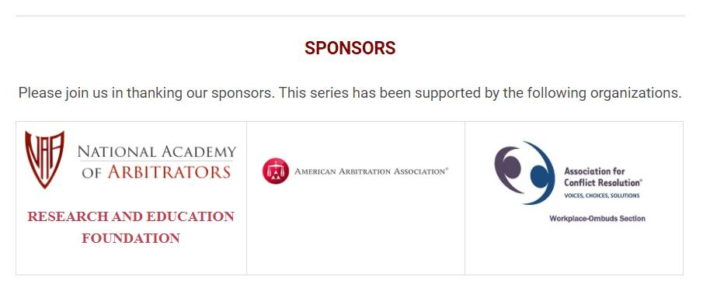
Adjourn and thank you
Next session begins at 2:30pm ET

