Slide 1

FUTURE OF OMBUDS
2:30 – 3:30 pm ET
Angela Dash• Chuck Howard • Arthur Pearlstein
Moderator
Sarah Miller Espinosa
LERA Dispute Resolution Section

Slide 2
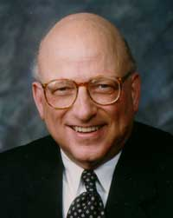
The “Future of Workplace ADR Series” is dedicated to
Professor David Lipsky (retired), Cornell University
Past President of LERA
(and mentor to hundreds)

Slide 3
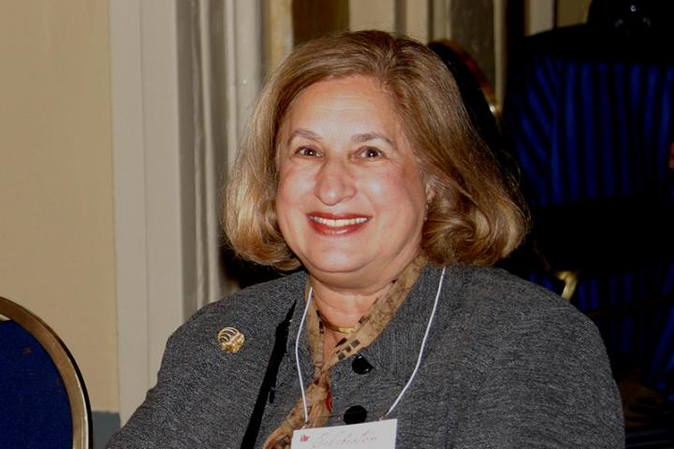
The “Future of Workplace ADR Series”
Honors the Memory of
Arbitrator Marcia Greenbaum
1941-2021
Past President, Pioneer Award Winner, Society of Professionals in DR; Lifetime Achievement Award, LERA;
Mentor, Leader, DR Program Developer

Slide 4
For our meeting today . . .
    Audience may pose questions/comments through Zoom chat
    Please stay muted throughout the program
    This session will be recorded and available on LERA website
    We will end on time after 60 minutes (3:30 pm ET)

Slide 5
Moderator: Sarah Miller Espinosa
Labor Arbitrator, Mediator, Ombuds
LERA DR Section Practice Lead for Ombuds
LERA Virginia Chapter, Board Member

Slide 6
Chuck Howard
Executive Director of the International Ombuds Association
Previously, Partner and General Counsel of Shipman & Goodwin LLP, where he represented ombuds offices at major corporations, universities, research facilities, and other organizations throughout the United States
Author of The Organizational Ombudsman: Origins, Roles and Operations – A Legal Guide

Slide 7
Angela Dash
Founder and President of The Pace Institute
20 years of public sector leadership and management experience
National Trainer; Executive and Professional Coach;
Organizational Ombuds
PhD in Conflict Analysis and Resolution with an emphasis in conflict in organizations, schools, and healthcare

Slide 8
Arthur Pearlstein
Director of Arbitration and Director of Shared Neutrals, Federal Mediation & Conciliation Service
Previous Roles at FMCS include: General Counsel; Director of ADR and International Programs; Commissioner of Mediation
Previously, Professor of Law and Director of the Werner Institute for Negotiation and Dispute Resolution at Creighton University School of Law

Slide 9
Session Overview
Today we will focus on the future of organizational ombuds in workplace conflict resolution. Organizational ombuds are “designated neutrals who are appointed or employed by an organization to facilitate the informal resolution of concerns of employees, students, and, sometimes, external clients of the organization.”

Slide 10
Session Overview
Organizational ombuds are impartial, confidential, independent conflict resolvers that informally aid in the resolution and mitigation of conflict within organizations by assisting individuals in identifying and assessing options to resolve concerns, as well as identifying systemic issues within the organization.

Slide 11
Questions for each panelist:
    What is your perspective on the current state of organizational ombuds programs, particularly those programs focused on the resolution of workplace conflict?
    What are your predictions on where and how organizational ombuds programs will evolve by 2031?

Slide 12
Audience Questions and Comments

Slide 13
You are invited to join LERA as a member
And complimentary membership in the
LERA Dispute Resolution Section (DRS)
www.leraweb.org

Slide 14
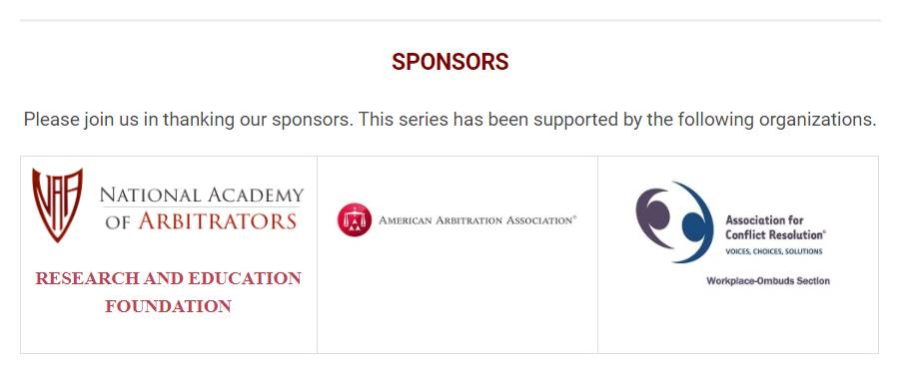
Thank You to our panelists and moderators who brought us nine sessions on the Future of Workplace Dispute Resolution.
Thank You to LERA Executive Director Emily Smith and Membership & Marketing Coordinator Bernadette Tiemann.
Thank You to the LERA Dispute Resolution Section leadership and particularly Richard Fincher for his vision and work in actualizing this series.

